Slide 1
ICE Check-ins Information for Newly Arriving Migrants and Asylum Seekers
May 2024

Slide 2
Welcome to Washington!
Bem-vindo!
¡Bienvenido!
Boyei malamu!

Slide 3
What is ICE?

Slide 4
ICE Check-Ins are not Immigration Court Hearings

Slide 5
Why do I have to check-in with ICE?
Ensure you attend your Immigration Court hearings
Confirm your contact information
Ensure compliance with supervision order and law

Slide 6
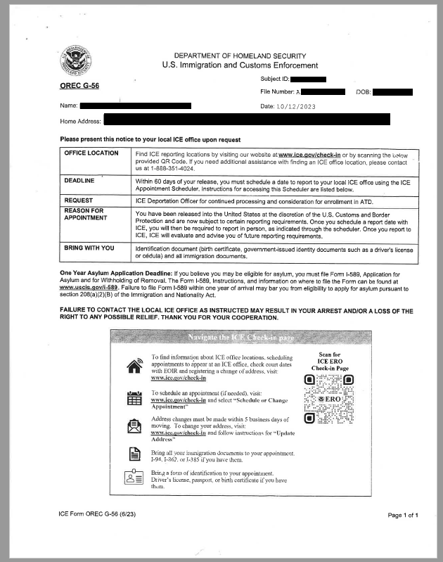
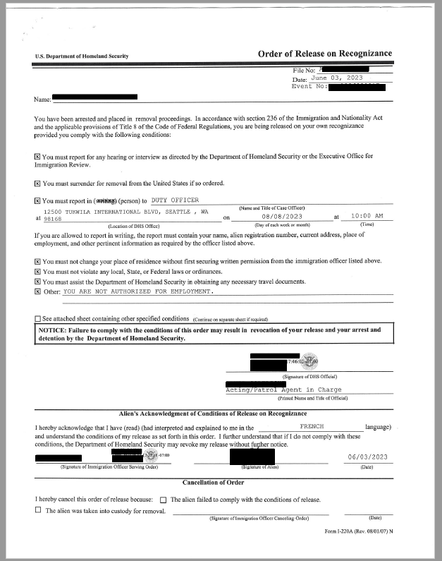
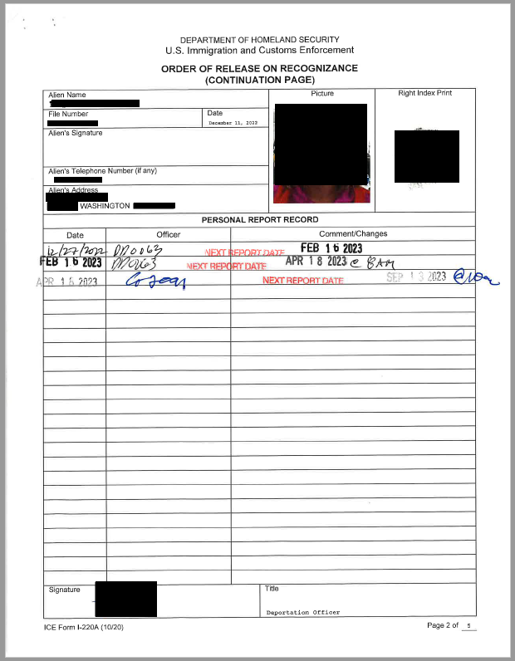
ICE Check-In Documents
Name & A Number
Name
A Number
Name
A Number

Slide 7
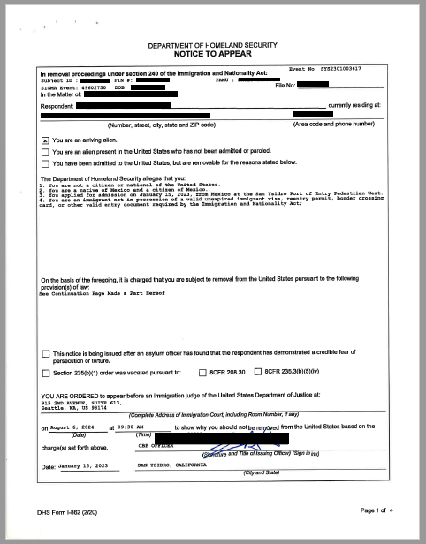
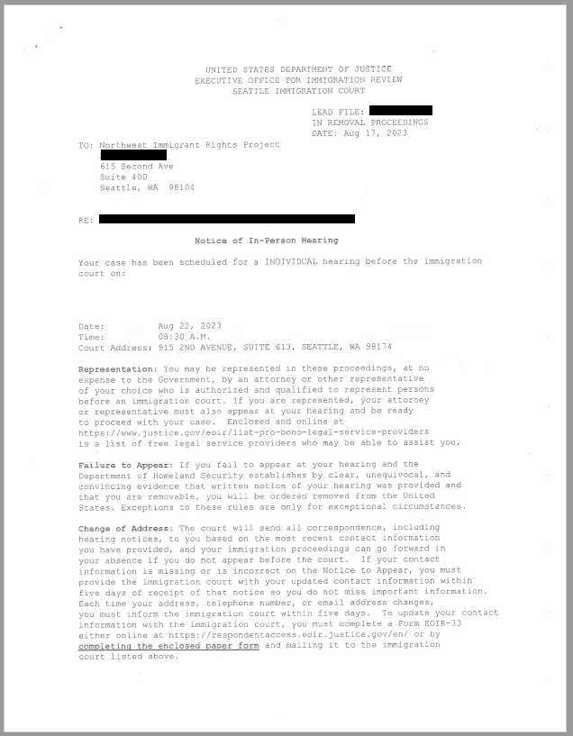
Immigration Court Documents

Slide 8
No Check-In Documents?
Email: ICE-ERO-SEA-SEANonDetainedDocket-SM@ice.dhs.gov
Telephone: (206) 277-2000, ext. 2
Appear in Person: 12500 Tukwila Int’l Blvd
PROVIDE YOUR “A NUMBER” AND FULL NAME

Slide 9
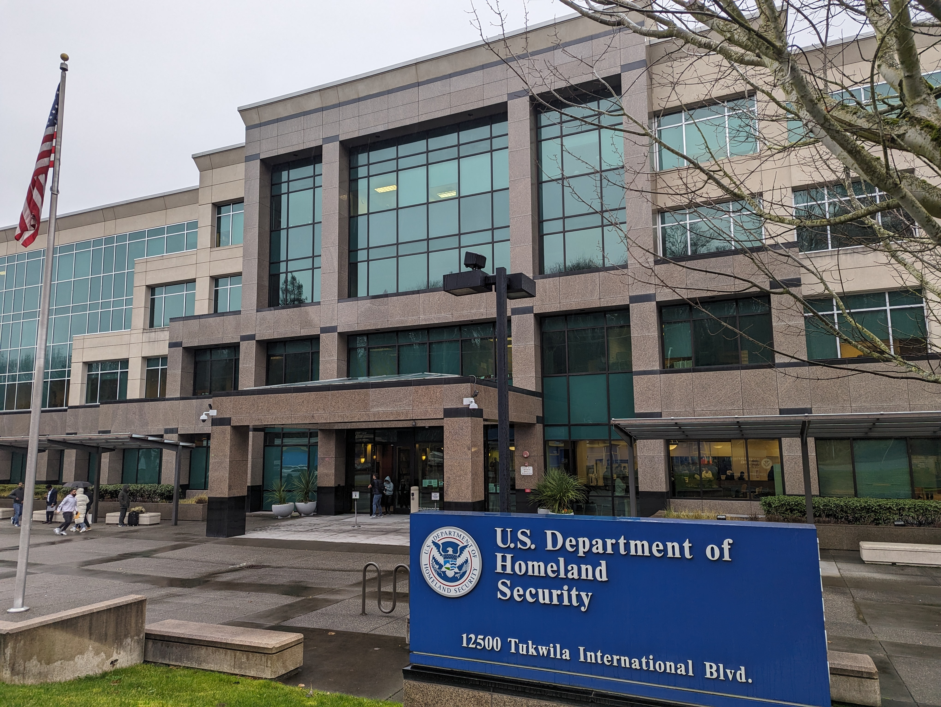
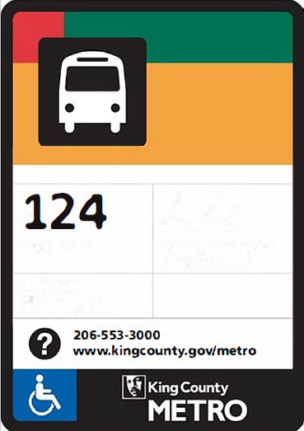
ICE Check-In Location
12500 Tukwila International Blvd
Tukwila, WA 98168
Bus 124

Slide 10
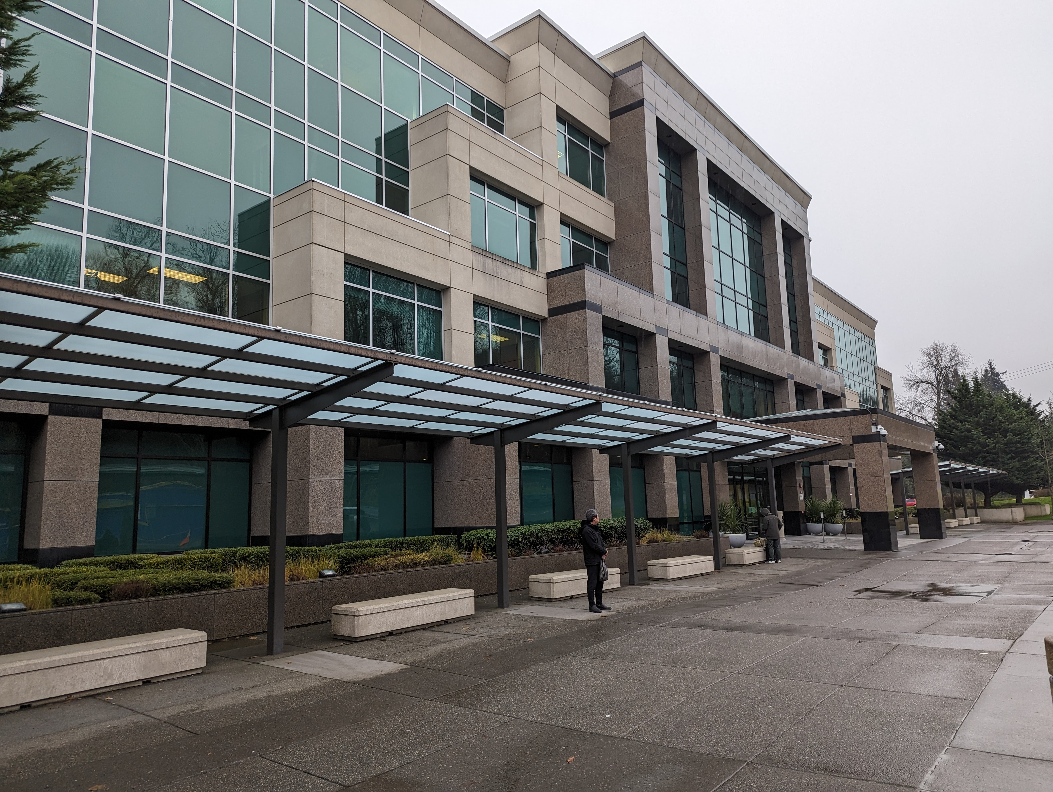
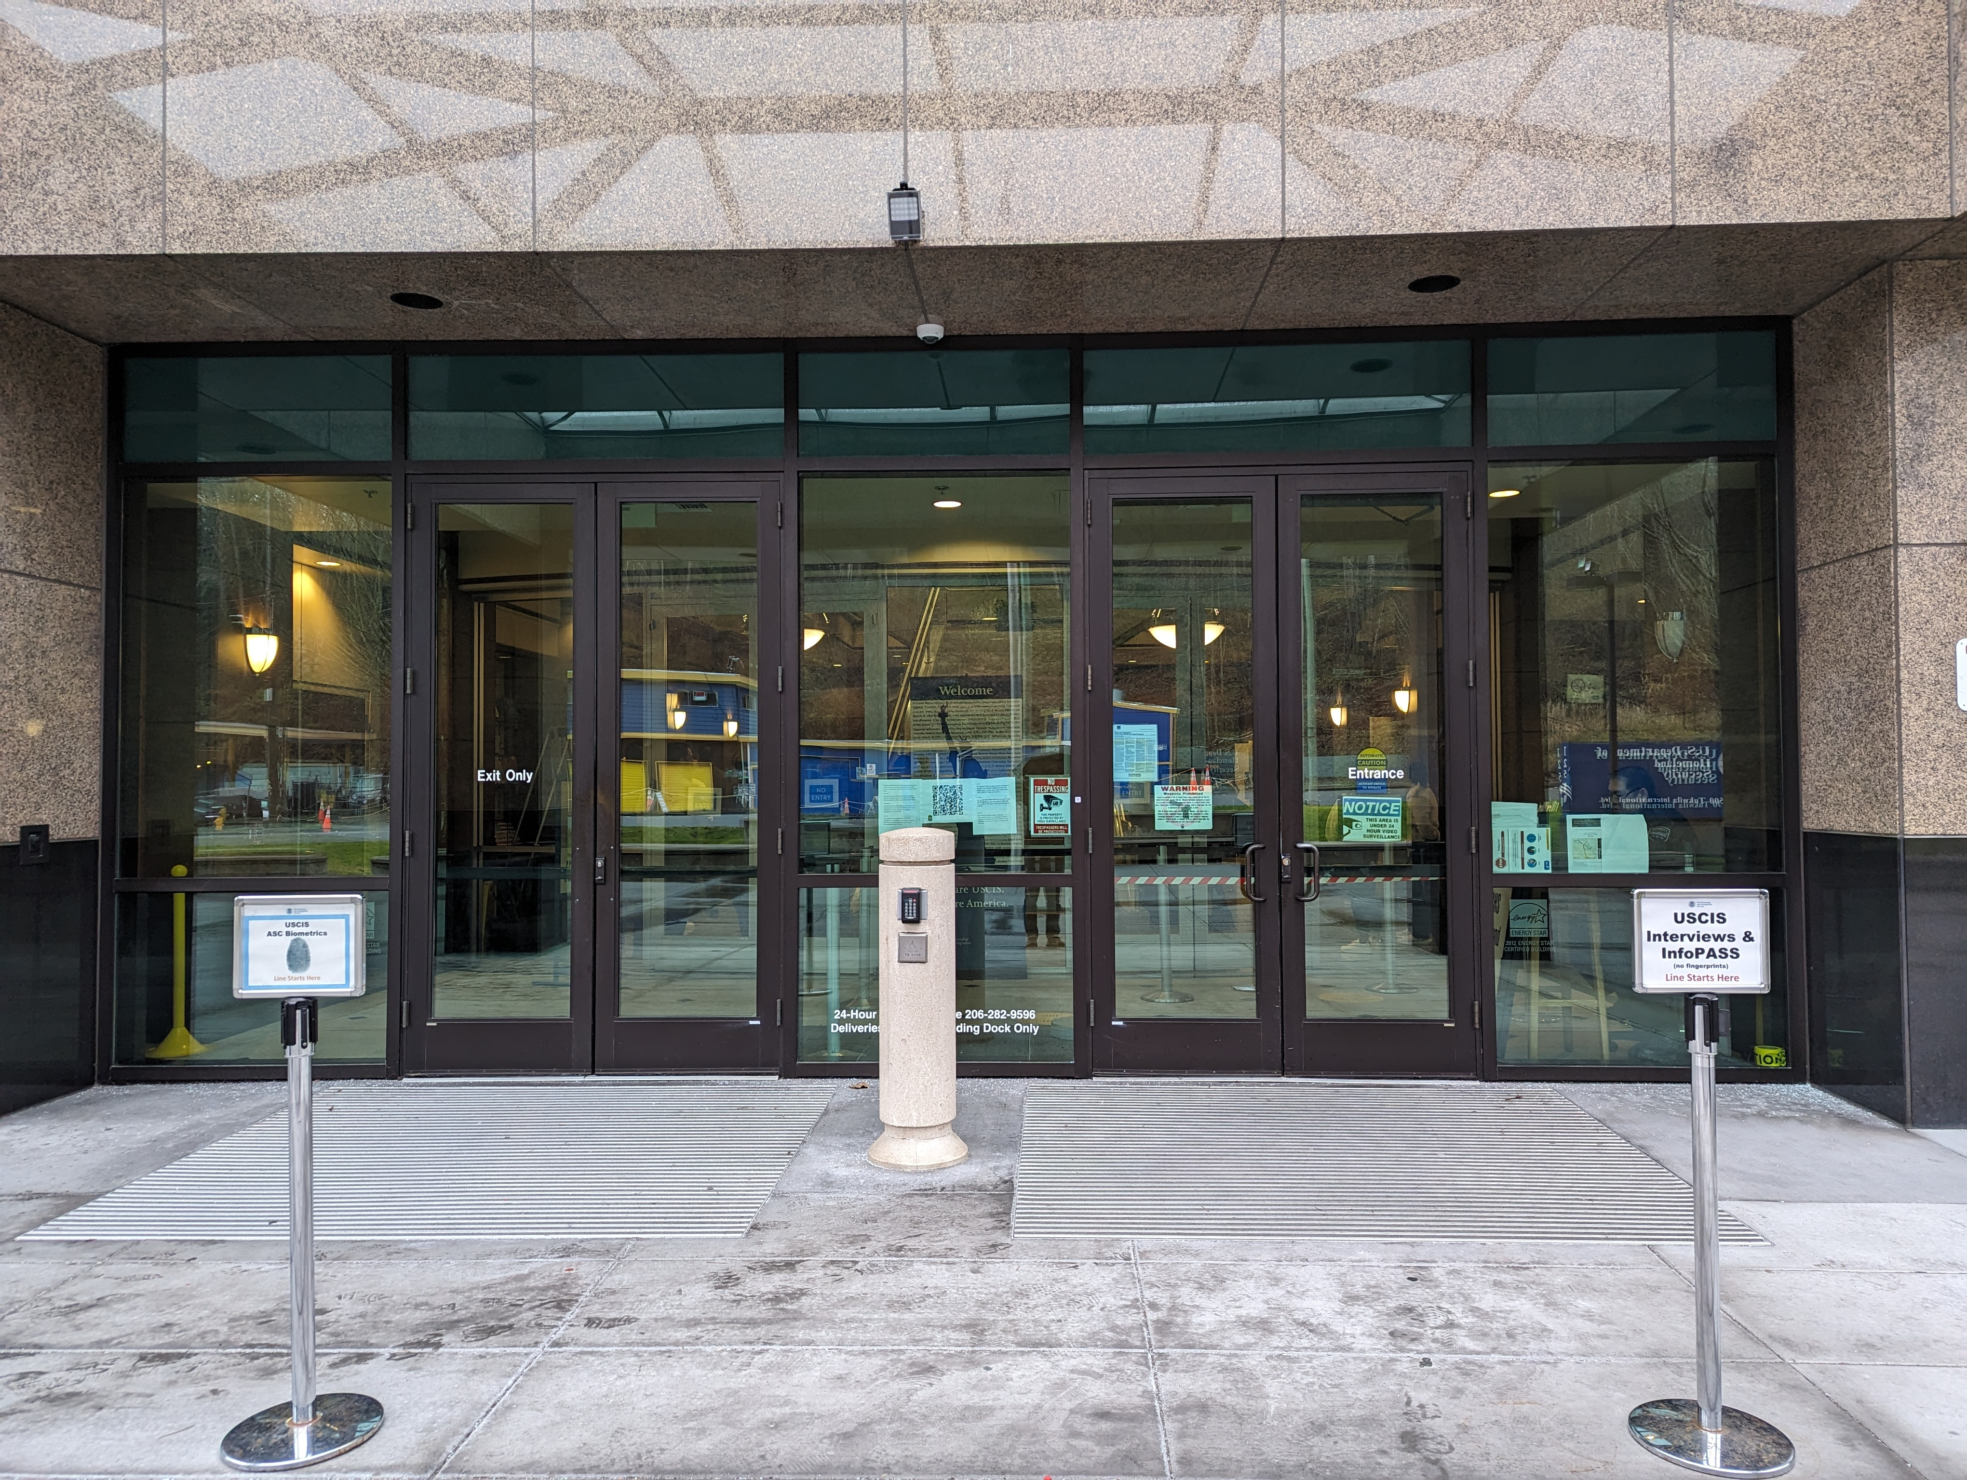
Preparing for ICE Check-Ins
You have the right to be represented by an attorney or accredited representative; ICE may allow you to bring family or community member for interpretation
Bring your immigration documents with you, including any appointment letter or order of supervision
Know your current address and phone number
Wait by the “ICE Check In” sign, or speak to the security guard at the front entrance
Be prepared to wait outside – prepare for the cold and rain!
Check-in

Slide 11
What Happens at the ICE Check-In?
Confirm contact information: home address, telephone number, work
Information about immigration court case
Fingerprints, compliance with Order of Supervision
Schedule next ICE check-in
Maybe: supervision changes - ankle monitor, home visits, cell phone app,detention

Slide 12
Common Questions
Will I be detained?
How long will it take?
What if I missed a check-in or need to reschedule?
What if I want to move to another state?
TALK TO A LAWYER BEFORE YOUR ICE CHECK-IN IF:
YOU HAD CONTACT WITH POLICE
MMIGRATION JUDGE ORDERED YOU REMOVED

Slide 13
For more immigration help please visit nwirp.org

