Slide 1
Asylum and Other Forms of Immigration Protection

Slide 2
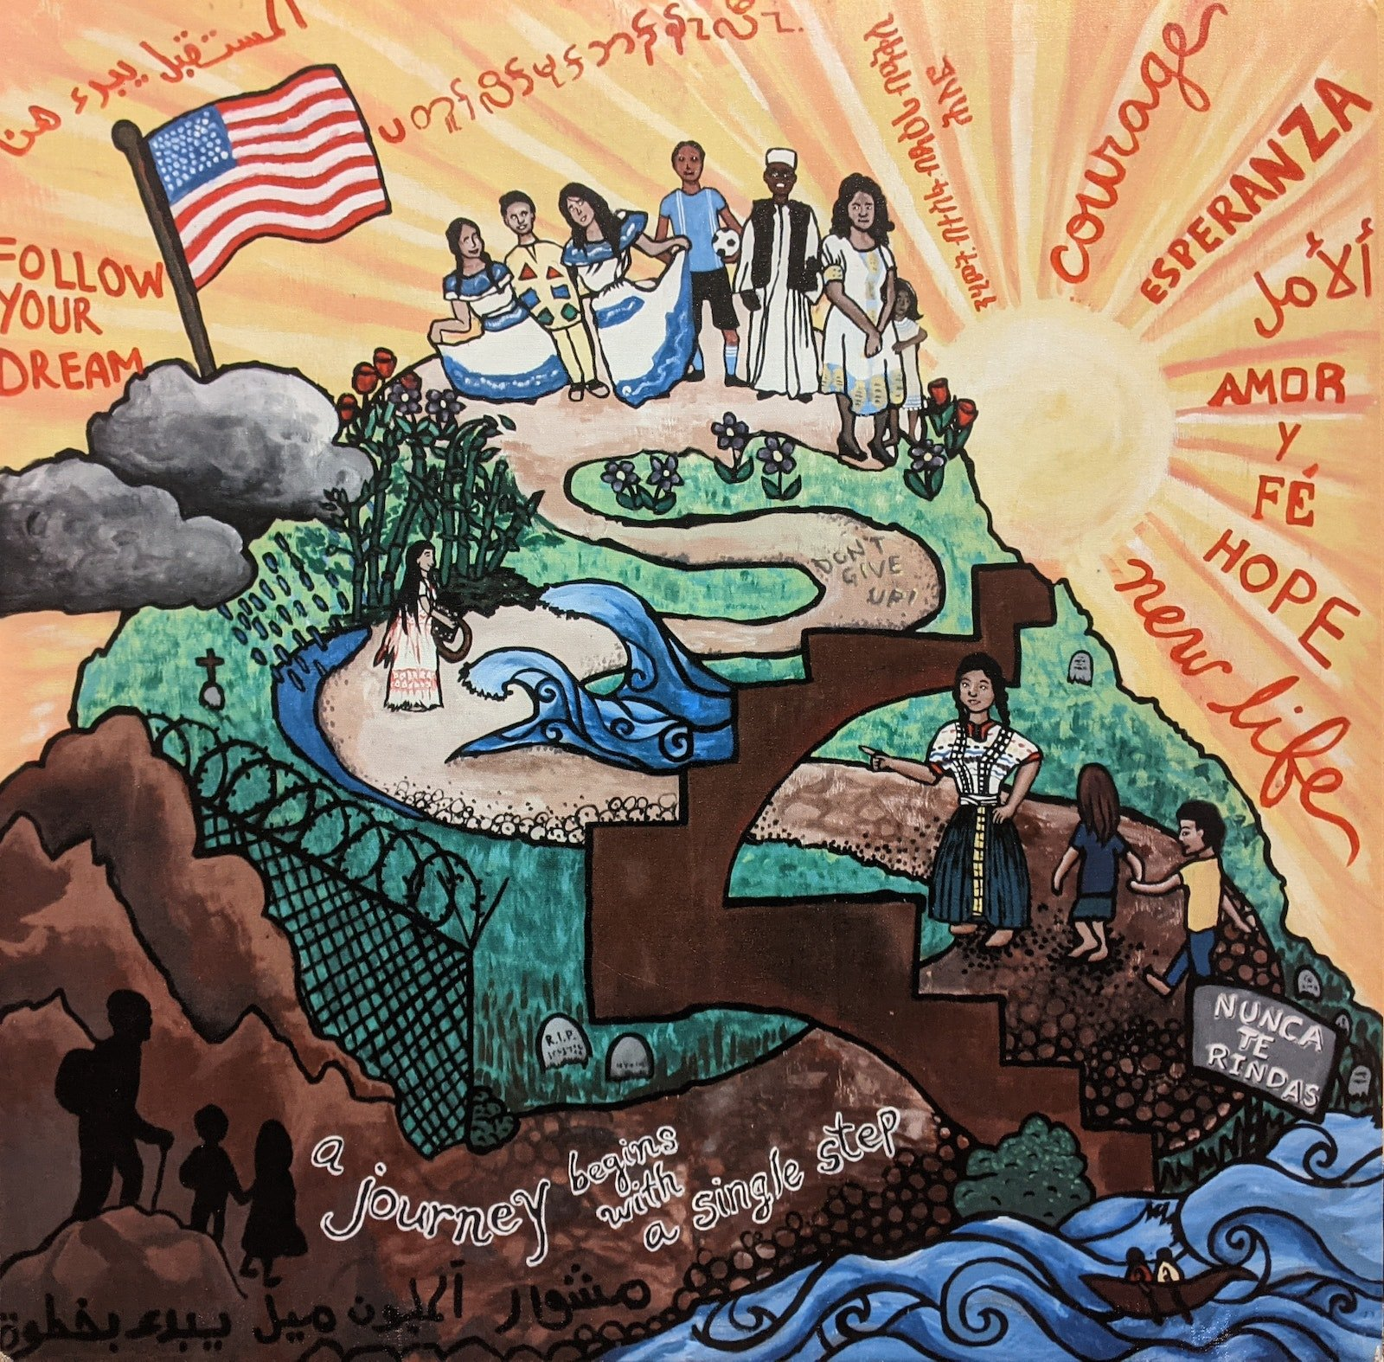
“Reflections on a Journey,” a mural created by refugee children in Michigan, was completed with the help of a professional artist in Lansing to commemorate World Refugee Awareness Week in 2015. Small canvas copies of the piece are on display at several art galleries in Michigan.​

Slide 3
Asylum case questions
Were you harmed in the past, or do you fear being harmed in the future?
Who harmed you, and why did they specifically target you to harm?
Is the government in your home country able or willing to protect you from harm?
Is there anywhere else in your country where you could live safely?

Slide 4
Who harmed you, and why did they specifically target you to harm?

Slide 5
Were you harmed in the past, or do you fear being harmed in the future?

Slide 6
Is the government in your home country able or willing to protect you from harm?

Slide 7
Is there anywhere else in your country where you could live safely?

Slide 8
Common Bars to Asylum
One-Year Filing Deadline
Firm Resettlement
Persecution of Others
Crimes
Terrorism

Slide 9
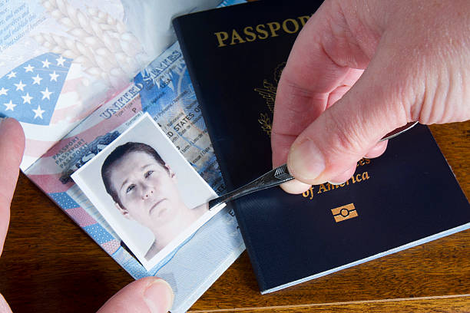
Credibility

Slide 10
Asylum Benefits
Indefinite status​
Work authorization​
Access to certain public benefits and refugee assistance ​
Derivative status for spouse and unmarried children under 21 ​
petition within 2 years of asylum grant​
Ability to travel with refugee travel document​
Adjustment of status (“green card”) after 1 year ​
Path to citizenship

Slide 11
Withholding of Removal and Protection Under the Convention Against Torture
Only available in immigration court
No filing deadline!
Withholding of Removal
Harm based on race, religion, nationality, political opinion, membership in a particular social group
Convention Against Torture
Torture by the government or by a person or group the government does not protect against
Benefits: Ability to stay in the U.S. and work authorization

Slide 12
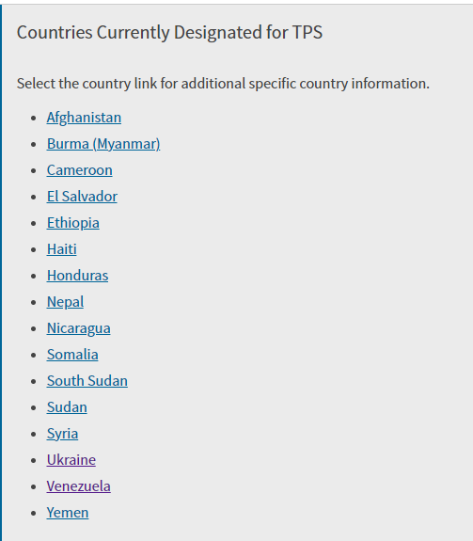
Temporary Protected Status (TPS)
A country may be designated for TPS for ongoing armed conflict, environmental disasters, extraordinary and temporary conditions, etc. ​
For citizens of certain countries who have been present since a specific time AND registered for TPS (or can sometimes file late). ​
TPS recipients can not be removed, and are eligible for work authorization

Slide 13
Additional Forms of Protection
VAWA Self Petition
U-Visa
T-Visa
Special Immigrant Juvenile Status

Slide 14
For more immigration help please visit nwirp.org

