Slide 1
IMMIGRATION COURT Information for Newly Arriving Migrant and Asylum Seekers
March 2024

Slide 2
Welcome to Washington!
Bem-vindo!
¡Bienvenido!
Boyei malamu!

Slide 3
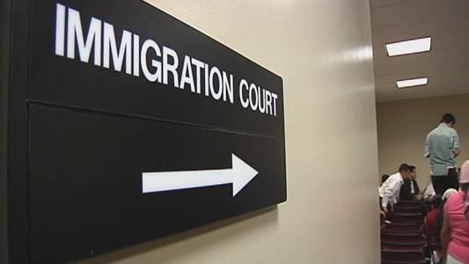
Seattle Immigration Court
Address 915 2nd Ave., Suite 613 Seattle, WA 98174

Slide 4
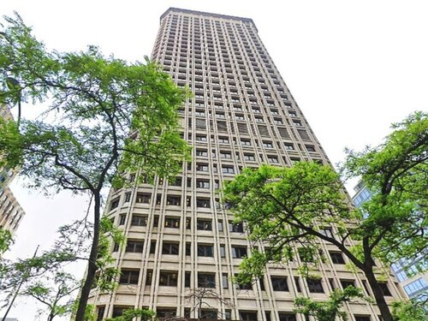
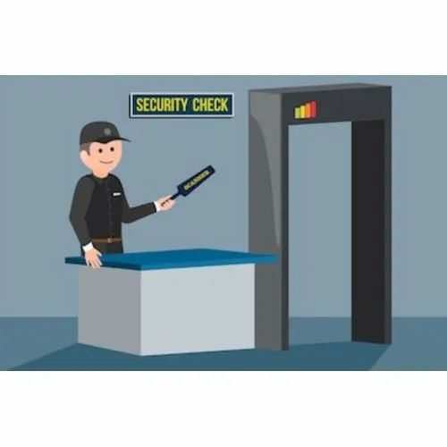
Seattle Immigration Court

Slide 5
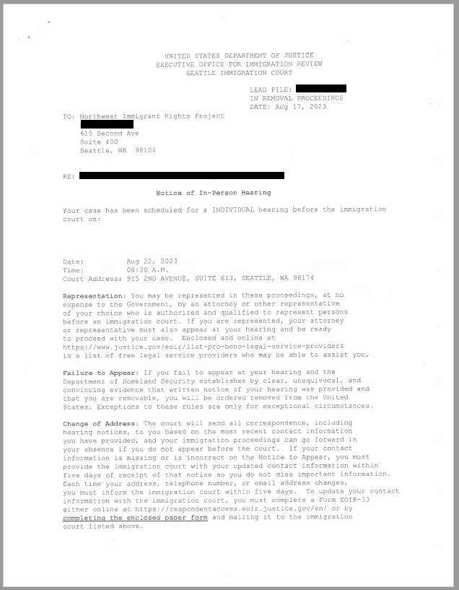
Notice of Hearing
Notice of In-Person Hearing
Date, Time and Court Address found here

Slide 6
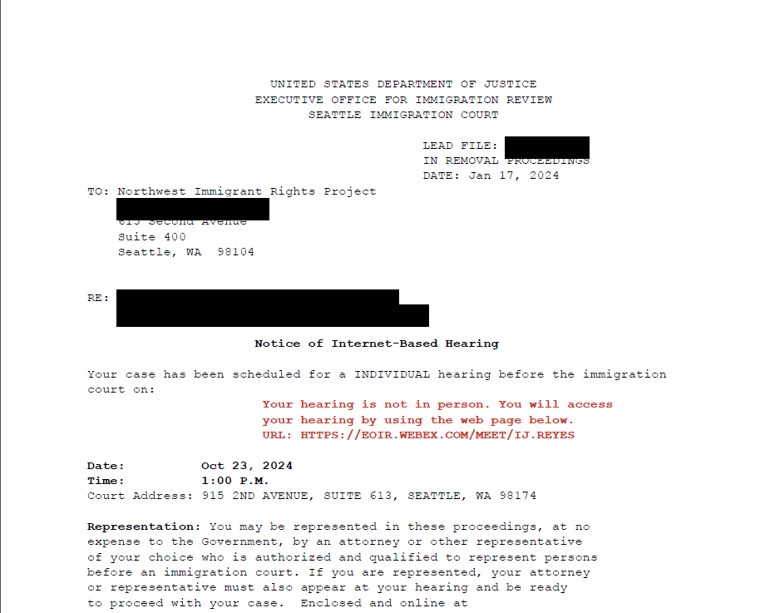
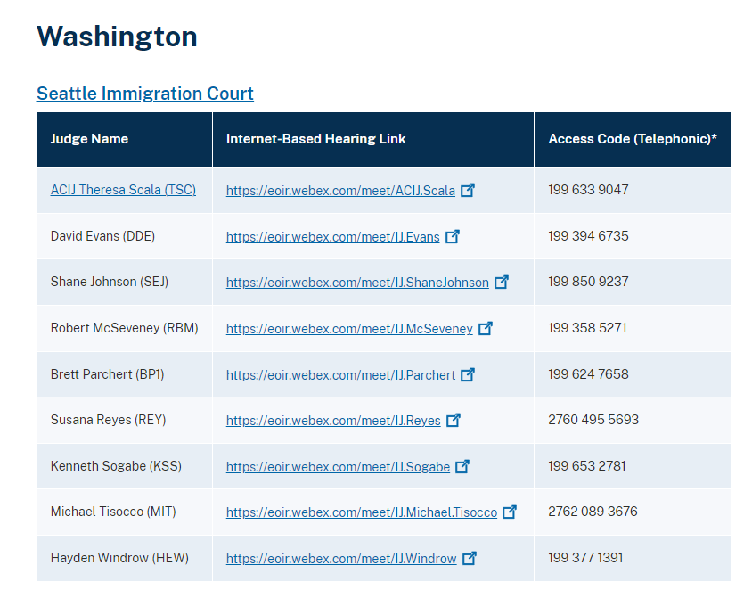
Notice of Hearing
http://justice.gov/eoir/find-immigration-court-and-access-internet-based-hearings

Slide 7
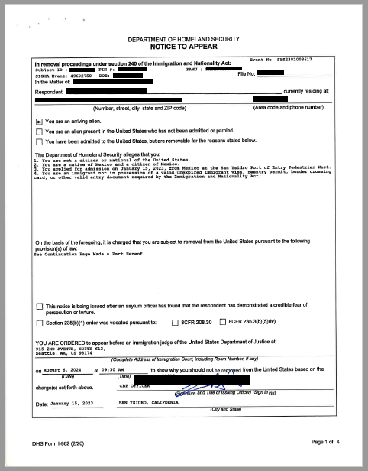
Notice to Appear
Notice to Appear
“Facts”/”Allegations”
You are ordered to appear before an immigration judge of the United States Department of Justice at:
915 2nd Avenue, Suite 613
Seattle, WA 98174

Slide 8
How to check your case status with the Immigration Court

Slide 9
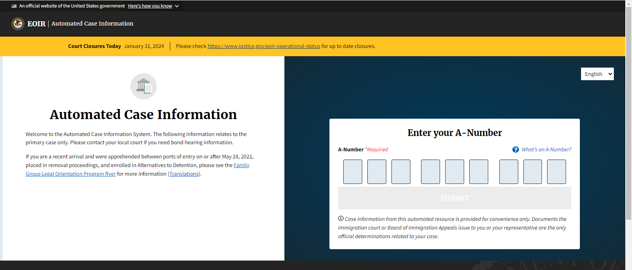
Automated Case Information Website
https://acis.eoir.justice/gov/en

Slide 10
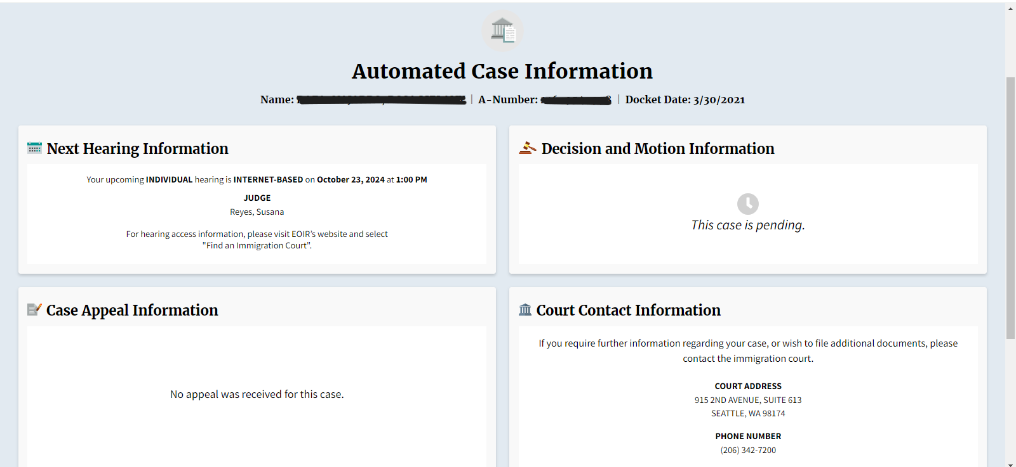
Automated Case Information Website

Slide 11
Case Information Hotline
Call the Hotline at 1-800-898-7180
Press “1” for information about the date, time, and location of your hearing, and to confirm the type of hearing;
Press “2” to review how many days have elapsed since you filed your asylum application with the Immigration Court;
Press “3” to confirm that your case is still pending before the Immigration Court, and to review any information about removal orders;
Press “4” to review any information about an appeal; or
Press “5” for information about filing documents or applications in your Immigration Case.

Slide 12
How to change your address with the Immigration Court

Slide 13
ICE check-ins are NOT immigration court hearings

Slide 14
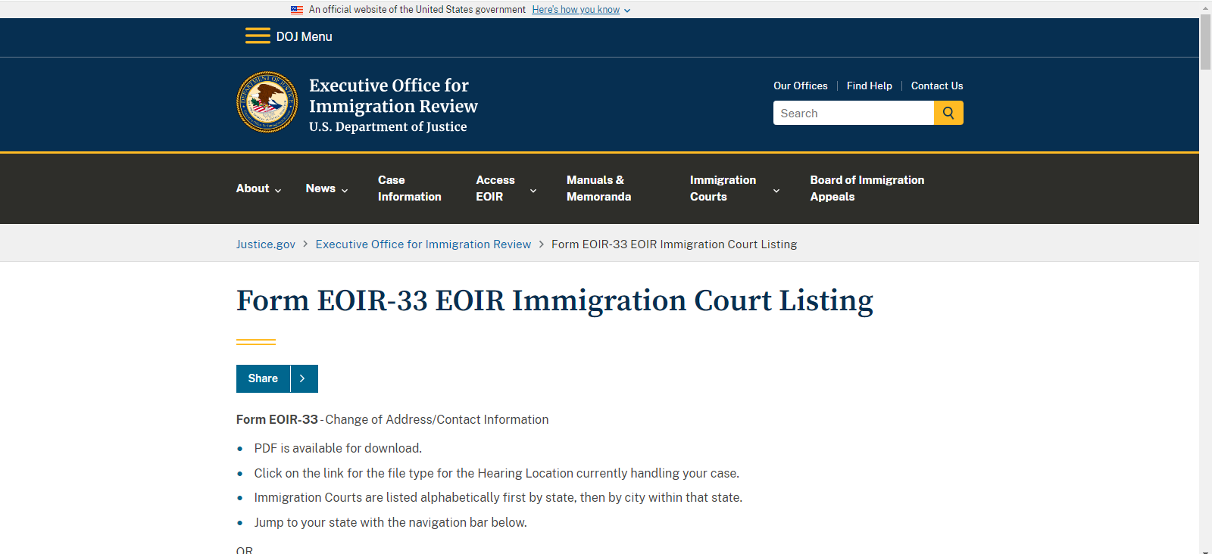
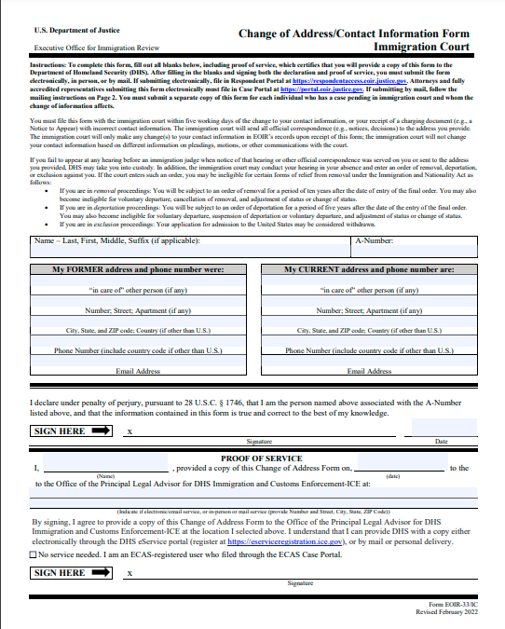
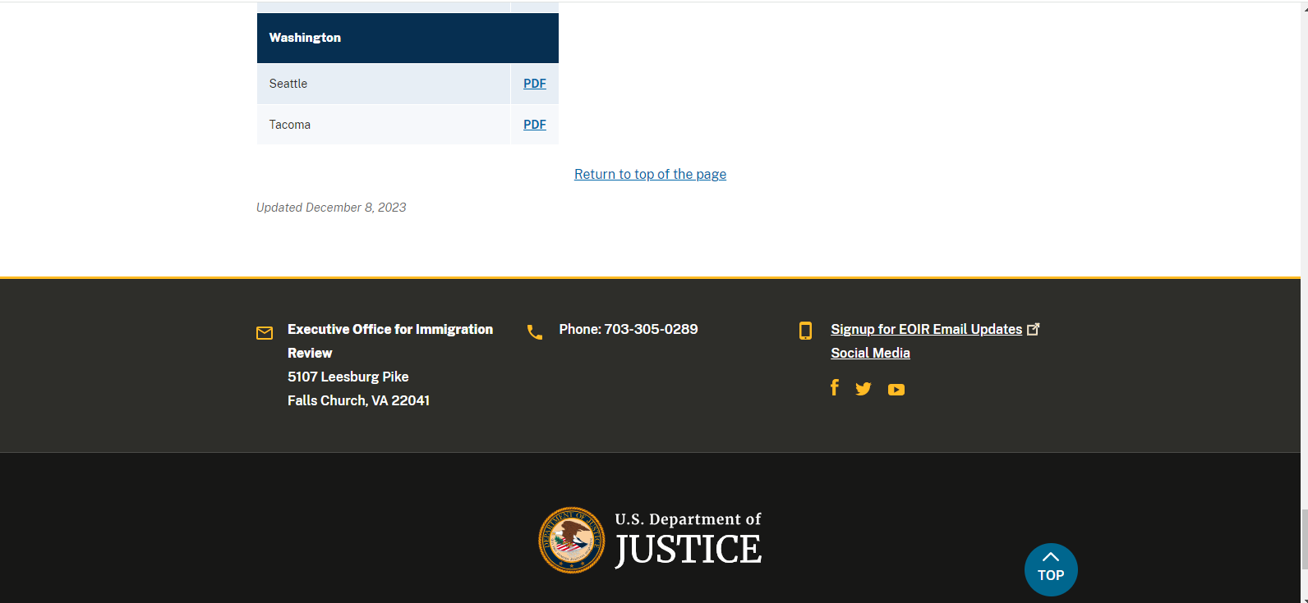
How to change your address with the Immigration Court?

Slide 15
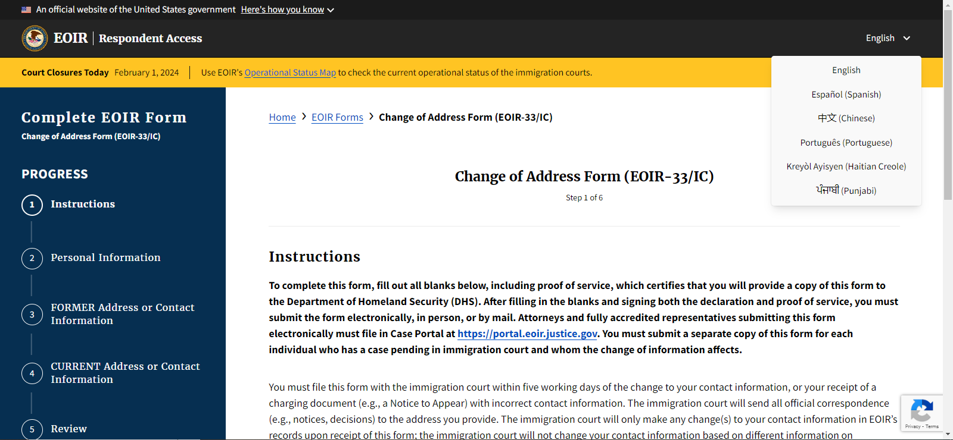
How to change your address with the Immigration Court
https://respondentaccess.eoir.justice.gov/en/forms/eoir33ic/

Slide 16
Reminder!
A true and exact copy of everything you submit to the immigration court, needs to be simultaneously provided to the government attorneys at the address below:
Office of the Principal Legal Advisor
DHS-ICE
915 Second Avenue, Suite 708
Seattle, WA 98174

Slide 17
Types of Hearings at the Immigration Court

Slide 18
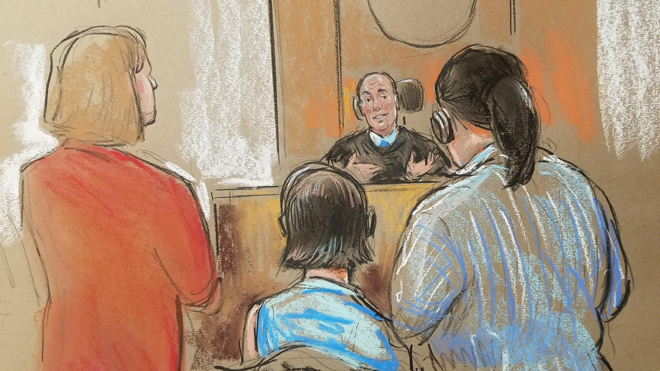
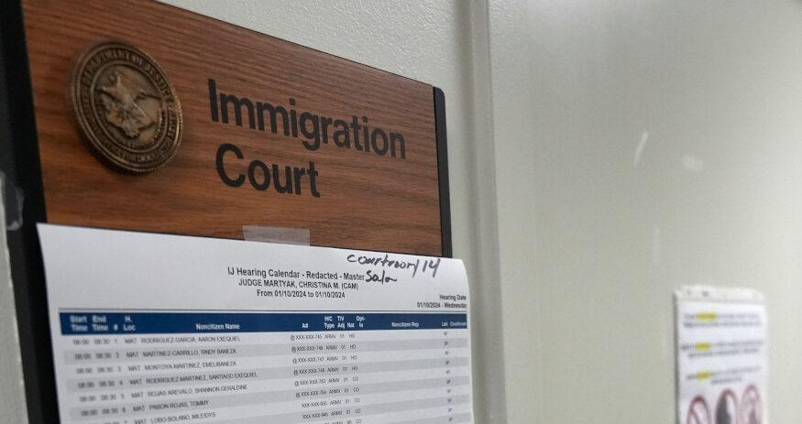
Your first Master Calendar Hearing
*Sketches by Bill Hennessy

Slide 19
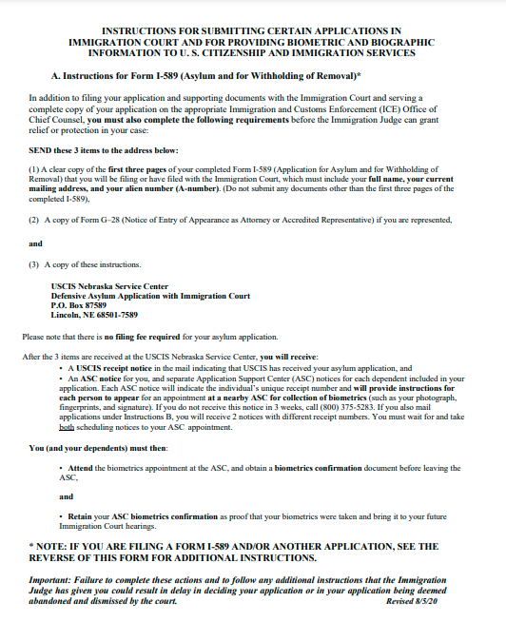
Other Master Calendar Hearings
“Facts” / “Allegations

Slide 20
Other Master Calendar Hearings
What can happen?
You will get another Master Calendar Hearing to submit your application for asylum or bring a lawyer;
You may be given a date to submit your asylum application and other evidence to the court;
You may be given the date for your individual or merits hearing

Slide 21
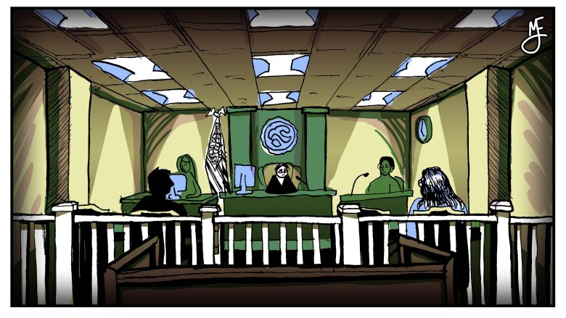
Individual Calendar Hearing
*Illustration by Michael Elizabeth Johnson

Slide 22
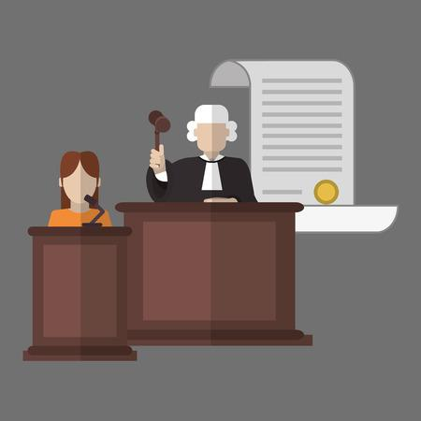
Individual Calendar Hearing
What is going to happen at my hearing?
You will be placed under oath
You will present your case to the judge, explaining why you decided to come to the United States.
Evidence that you can present to support your case:
Documents (such as police reports, medical reports, etc.), newspaper articles, country conditions reports
Testimony from others

Slide 23
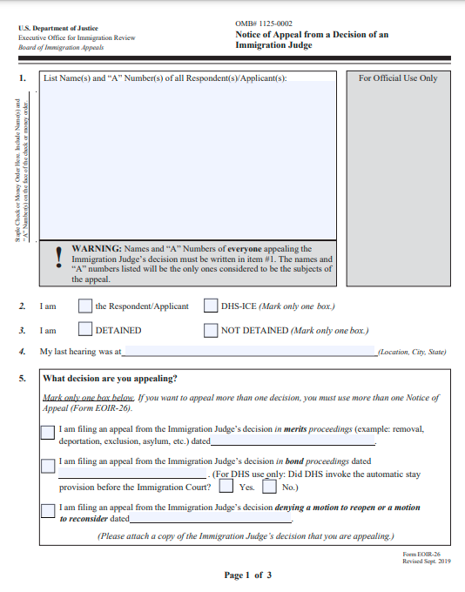
What if my case is denied?
Notice of Appeal
Board of Immigration Appeals
Clerk’s Office
5107 Leesburg Pike, Suite 2000
Falls Church, VA 22041
Office of the Principal Legal Advisor, DHS-ICE
915 Second Avenue, Suite 708
Seattle, WA 98174

Slide 24
For more immigration help please visit nwirp.org

Slide 25
